Slide 1

No Office. No Problem.
Join Tech@Home Webinar Series
40 days technical expertise exchange
Register for more: www.meetup.com/IBM-Cloud-MEA/

Slide 2


Predict Customer Churn Using a SPSS Modeler Flow
—
Khalil Faraj Developer Advocate, UAE Lungelo Sikobi Developer Advocate, South Africa
Get Started Here: http://ibm.biz/SPSSModelerWebinar

Slide 3
Agenda
What is Machine Learning? 04
Machine Learning Types 05
Machine Learning Process 06
Challenges 07
IBM SPSS Modeler 08
Why SPSS Modeler? 09
Nodes Palette 10
Hands-On 11
Helpful Links 12
Call for Code 2020 13
Predict Customer Churn Using a SPSS Modeler Flow / June 7, 2020 / © 2020 IBM Corporation

Slide 4
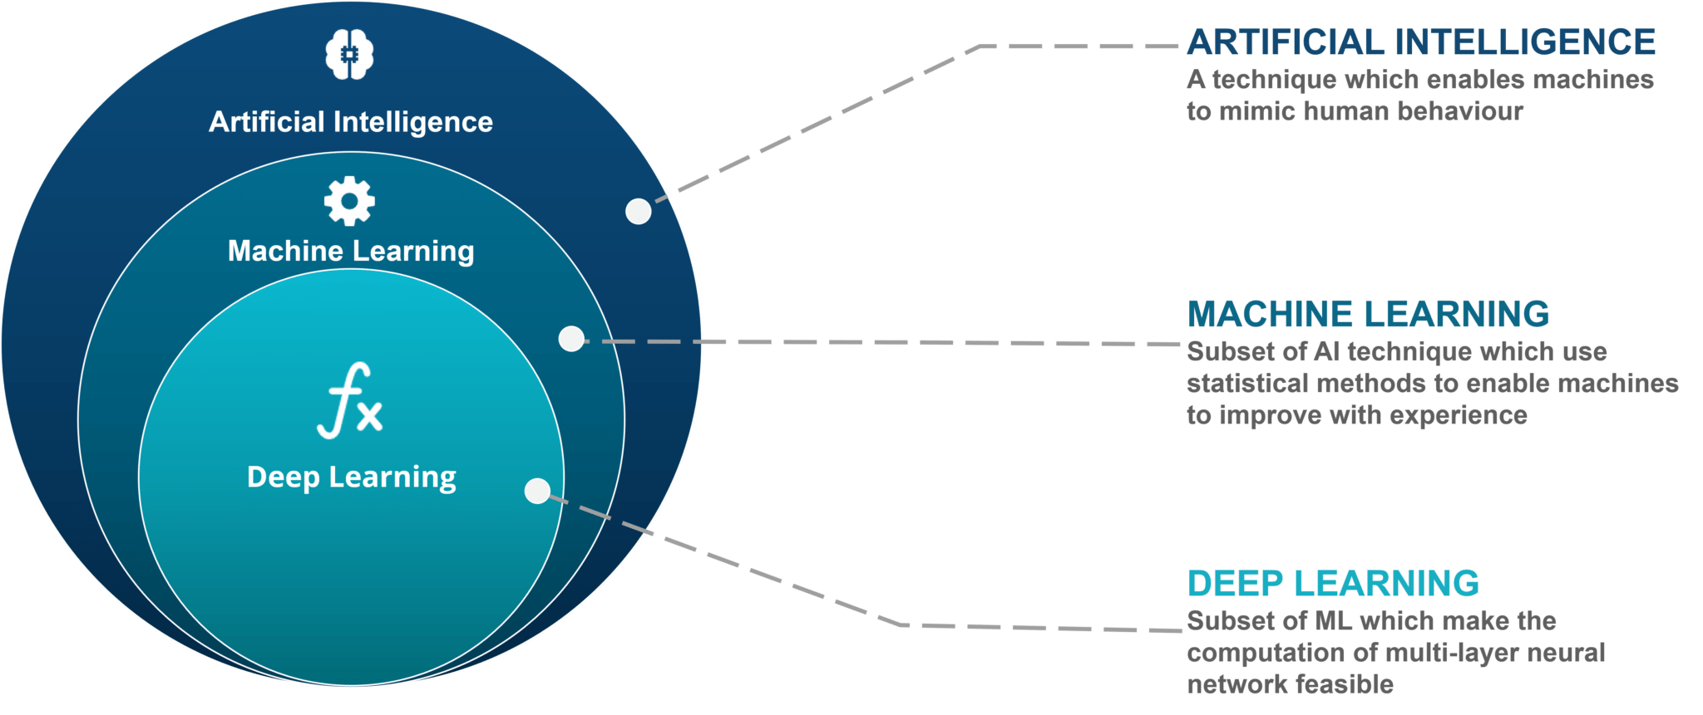
What is Machine Learning?
Predict Customer Churn Using a SPSS Modeler Flow / June 7, 2020 / © 2020 IBM Corporation

Slide 5
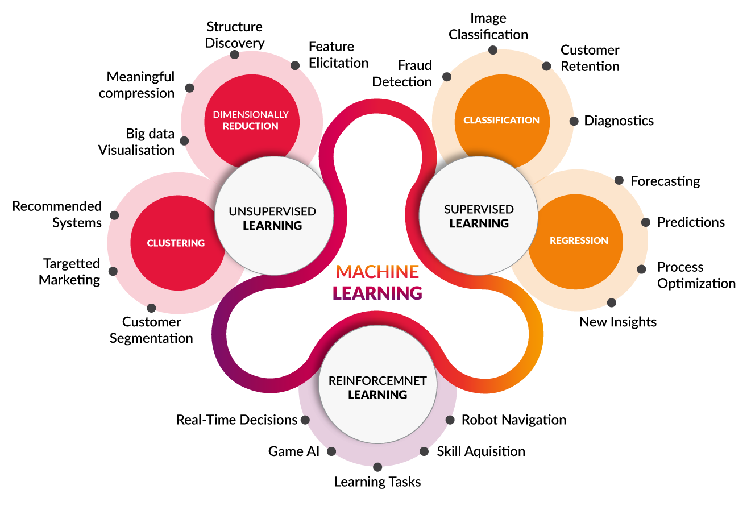
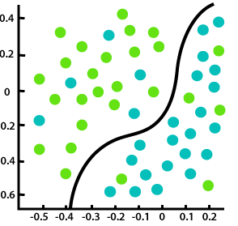
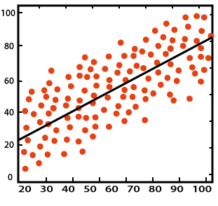
Machine Learning Types
Predict Customer Churn Using a SPSS Modeler Flow / June 7, 2020 / © 2020 IBM Corporation

Slide 6
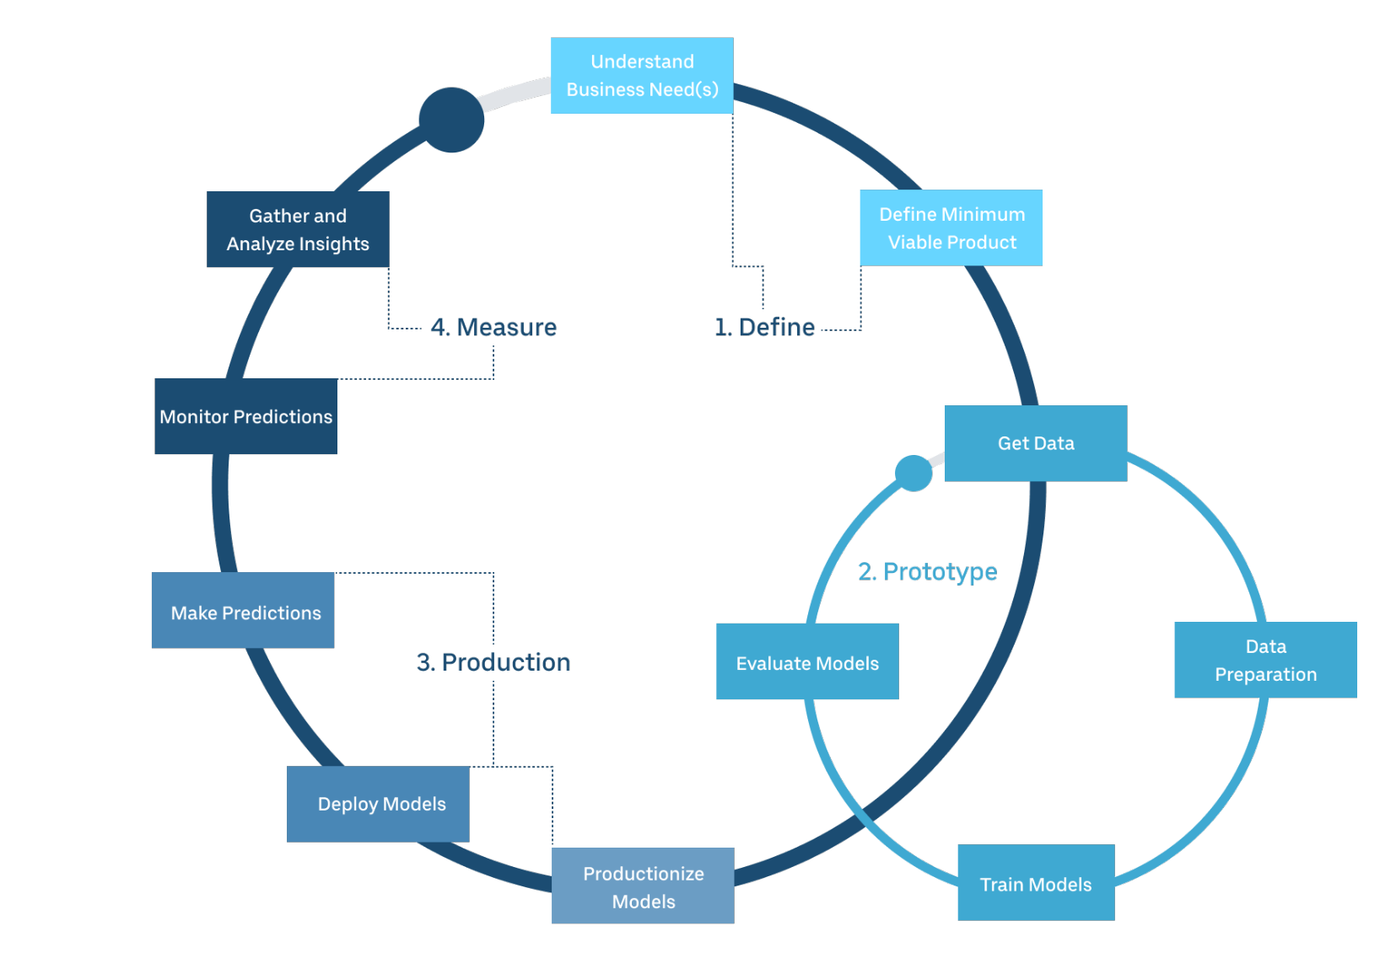
ML Process
Define the problem and solution
Develop and prototype the model
Produce the model
Measure the model
Predict Customer Churn Using a SPSS Modeler Flow / June 7, 2020 / © 2020 IBM Corporation
Notes:
Machine learning is an iterative step.
Models have various parameters (hyperparameters) that define the model performance. These hyperparameter values differ from one use case to another.
Training, Validation, and Evaluation should be done on different sets with the same distribution. This is typically done by splitting the available data.
Train-Validate-Test Split:
Smaller Datasets: 60-20-20
Larger Datasets: 80-10-10
Huge Datasets (DL): 98-1-1

Slide 7

Main Challenges These Days
High demand for data scientists and ML engineers
Lack of skills to meet the demand
Traditional ML techniques are time consuming and require a lot of effort
Predict Customer Churn Using a SPSS Modeler Flow / June 7, 2020 / © 2020 IBM Corporation

Slide 8


IBM SPSS Modeler
SPSS Modeler $≠$ SPSS Statistics
Data Science and machine learning solution
Data mining and text analytics software application
Used to build predictive models
Predict Customer Churn Using a SPSS Modeler Flow / June 7, 2020 / © 2020 IBM Corporation
Notes:
Machine learning is an iterative step.
Models have various parameters (hyperparameters) that define the model performance. These hyperparameter values differ from one use case to another.
Training, Validation, and Evaluation should be done on different sets with the same distribution. This is typically done by splitting the available data.
Train-Validate-Test Split:
Smaller Datasets: 60-20-20
Larger Datasets: 80-10-10
Huge Datasets (DL): 98-1-1

Slide 9

Why SPSS Modeler?
No programming is required
Automates tedious tasks that are time consuming in traditional ML approaches
Easy to use visual interface with drag and drop feature to build, evaluate, test and deploy a ML model
Boost productivity
Predict Customer Churn Using a SPSS Modeler Flow / June 7, 2020 / © 2020 IBM Corporation
Notes:
Machine learning is an iterative step.
Models have various parameters (hyperparameters) that define the model performance. These hyperparameter values differ from one use case to another.
Training, Validation, and Evaluation should be done on different sets with the same distribution. This is typically done by splitting the available data.
Train-Validate-Test Split:
Smaller Datasets: 60-20-20
Larger Datasets: 80-10-10
Huge Datasets (DL): 98-1-1

Slide 10
Nodes Palette
SPSS Modeler has 8 main nodes that we can use to build our flow:
Import Node: Data source (data asset, user input, simulated data)
Records Ops: Perform operations on Data records (merge, aggregate,…)
Field Ops: Perform operations in Data fields (filtering, manage values,… )
Modeling: Define model builders (ML algorithms)
Text Analytics: Perform text mining operations
Graph: Perform data visualizations with chart builders
Output: Model results
Export: Export the results so they can be viewed in external apps
Predict Customer Churn Using a SPSS Modeler Flow / June 7, 2020 / © 2020 IBM Corporation

Slide 11

Hands On
Sign up/Log in to your IBM Cloud Account http://ibm.biz/SPSSModelerWebinar
Follow along for the hands-on http://ibm.biz/SPSSModelerCodeLab
Predict Customer Churn Using a SPSS Modeler Flow / June 7, 2020 / © 2020 IBM Corporation
Notes:
IBM Watson® Studio helps data scientists and analysts prepare data and build models at scale across any cloud.

Slide 12

Useful Links
Learn – develop – connect
Get Started Here (https://ibm.biz/DigitalSummit)
Getting Started with SPSS Modeler (https://ibm.co/3dp3zua)
IBM Developer (https://developer.ibm.com/)
Data Science Community (http://ibm.biz/community-coursera)
Meetup (https://www.meetup.com/IBMCloud-Dubai/)

Slide 13
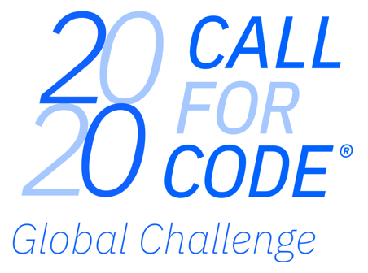



Build solutions that fight back.
Build & deploy solutions to help seize & reduce the impact of COVID-19
Build & deploy solutions to help halt & reverse the impact of Climate Change
In 2020, Call for Code is aligned to the UN 75th anniversary global conversation theme of climate change, with a focus on:
water sustainability
energy sustainability
disaster resiliency
The 2020 Call for Code Global Challenge is being expanded to address the COVID-19 pandemic, with a focus on:
crisis communication
remote education
community cooperation
Join a movement of:
210,000+ problem solvers
165+ nations
8,000+ applications built
Have the chance to win:
$200,000 USD
Open Source support from The Linux Foundation
Meetings with mentors & potential investors
Implementation support through Code and Response™
Call for Code Founding Partner
Call for Code Creator
Call for Code Charitable Partner
Call for Code Affiliate
Notes:
IBM is excited to announce 2020 Call for Code Global Challenge. Years 1 and 2 of Call for Code demonstrated the remarkable ability of developers to innovate for social good. In the past 2 years over 210,000 participants joined the movement from 165 nations where over 8,000 applications geared towards solving the worlds most pressing issues have been created. This year’s Call for Code is challenging applicants to create innovations based on open source technologies to bring solutions to 2 critical areas. 2020 Call for Code is aligned with the UN 75th anniversary global conversation theme of climate change. In addition to this area, the unprecedented effect of the COVID-19 global pandemic means we must unite and act swiftly to combat what has the potential to become the greatest crisis of modern times. With both Climate Change and COVID-19 being such alarming areas of concern, that’s why we have expanded the 2020 Call for Code Global Challenge to address both climate change and the world's reaction to COVID-19 -- two pressing issues that have the power to compromise our health, our planet, and our survival. The 2020 Call for Code Global Challenge arms you -- developers, visionaries, problem solvers -- with resources to build open source technology solutions that address these issues. The Climate Change track is calling for problem solvers to address three focus areas: water sustainability, energy sustainability, and disaster resiliency. The COVID-19 track is calling for problem solvers to address crisis communication, remote education, and community cooperation. Be a part of something that is bigger than yourself, and use your talents to build solutions to fight back and epitomize the essence of using tech for good.

Slide 14


callforcode.org

Slide 15
Thank you.
Khalil Faraj
Developer Advocate, UAE
khalil.faraj@ibm.com
Lungelo Sikobi
Developer Advocate, South Africa
kungelo.sikobi@ibm.com
Predict Customer Churn Using a SPSS Modeler Flow / June 7, 2020 / © 2020 IBM Corporation

